Slide 1
SOFTWARE PROJECT MANAGEMENT
Risk and Change Management
Dr. Seemab Latif
Lecture No. 9
12th April, 2011

Slide 2
Project Risk Management
It is the art and science of identifying, assigning, and responding to risk throughout the life of a project and in the best interests of meeting project objectives.

Slide 3
Project Risk
Characterized by:
  Uncertainty (0 < probability < 1)
  An associated loss (money, life, reputation, etc)
  Manageable – some action can control it
Problem
  A risk that has materialized

Slide 4
Risk Management
Problems that haven’t happened yet
Why is it hard?
You need to define a strategy early in your project
Job of risk management: Identification, Analysis, Control
Goal: avoid a crisis

Slide 5
Causes of Risk
Shifting user requirements
Poor schedule estimates
Unreliable contractors
Management inexperience
Technology failures
Changing government regulations
Performance shortfalls
Many more……

Slide 6
Levels of Risk Management
You can address risks at any of several levels.
Crisis management—Fire fighting; address risks only after they have become problems.
Fix on failure—Detect and react to risks quickly, but only after they have occurred.
Risk mitigation—Plan ahead of time to provide resources to cover risks if they occur, but do nothing to eliminate them in the first place.
Prevention—Implement and execute a plan as part of the software project to identify risks and prevent them from becoming problems.
Elimination of root causes—Identify and eliminate factors that make it possible for risks to exist at all.
Source: Adapted from A Manager's Guide to Software Engineering (Pressman 1993).

Slide 7
Subcategories of Risk Management
Generally, risk management is made up of risk assessment and risk control. These, in turn, are made up of several subcategories.
“Software Risk Management”, Boehm, 1989

Slide 8
Subcategories of Risk Management: Risk Assessment
Risk assessment is made up of risk identification, risk analysis, and risk prioritization:
  Risk identification produces a list of risks that have the potential to disrupt the project's schedule.
  Risk analysis assesses the likelihood and impact of each risk and the risk levels of alternative practices.
  Risk prioritisation produces a list of risks prioritised by impact. This list serves as a basis for risk control.

Slide 9
Subcategories of Risk Management: Risk Control
Risk control is made up of risk-management planning, risk resolution, and risk monitoring:
  Risk-management planning produces a plan for dealing with each significant risk. It also makes sure that the risk-management plans for each of the individual risks are consistent with each other and with the overall project plan.
  Risk resolution is the execution of the plan for dealing with each significant risk.
  Risk monitoring is the activity of monitoring progress toward resolving each risk item. Risk monitoring can also include the ongoing activity of identifying new risks and feeding them back into the risk-management process.

Slide 10
Risk Identification--Example
What are the most Common Schedule Risks: keeping in mind the CLASSIC MISTAKES case study?

Slide 11
People-Related Mistakes | Process-Related Mistakes | Product-Related | Technology
1. Undermined motivation 2. Weak personnel 3. Uncontrolled problem employees 4. Heroics 5. Adding people to a late project 6. Noisy, crowded offices 7. Friction between developers and customers 8. Unrealistic expectations 9. Lack of effective project sponsorship 10. Lack of stakeholder buy-in 11. Lack of user input 12. Politics placed over substance 13. Wishful thinking | 14. Overly optimistic schedules 16. Insufficient risk management 17. Contractor failure Insufficient planning 18. Abandonment of planning under pressure 19. Wasted time during the fuzzy front end 20. Shortchanged upstream activities 21. Inadequate design 22. Shortchanged quality assurance 23. Insufficient management controls 24. Premature or too frequent convergence 25. Omitting necessary tasks from estimates 26. Planning to catch up later 27. Code-like-hell programming | 28. Requirements gold-plating 29. Feature creep 30. Developer gold-plating 31. Push me, pull me negotiation 32. Research-oriented development | 33. Silver-bullet syndrome 34. Overestimated savings from new tools or methods 35. Switching tools in the middle of a project 36. Lack of automated source-code control

Slide 12
Risk Identification Example
1. Feature creep
2. Requirements or developer gold-plating
3. Shortchanged quality
4. Overly optimistic schedules
5. Inadequate design
6. Silver-bullet syndrome
7. Research-oriented development
8. Weak personnel
9. Contractor failure
10. Friction between developers and customers

Slide 13
Risk Analysis
After you've identified the risks to your project, the next step is to analyse each risk to determine its impact.
You can use risk analysis to help choose among several development options, or you can use it to manage the risks associated with an option you've already chosen.
Risk Exposure RE: a useful risk-analysis practice is to determine the "risk exposure" of each of the risks you've identified.

Slide 14
Risk Exposure
Risk exposure is equal to the probability of the unexpected loss multiplied by the size of the loss.
For example, if you think there's about a 25% chance that it will take 4 weeks longer than expected to get your project approved, the risk exposure would be 25 %multiplied by 4 weeks, which equals 1 week.

Slide 15
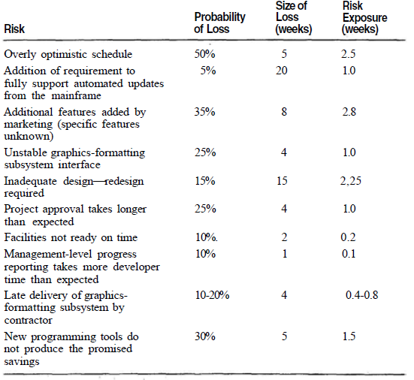
Example of a Risk-Assessment Table

Slide 16
Risk Prioritization
Once you've created the list of risks, the next step is to prioritise the risks so that you know where to focus your risk-management efforts.
After you've computed the risk exposure by multiplying the probability of the loss by the size of the loss, sort the risks in your risk-assessment table by the risk exposure and see what you've got.

Slide 17
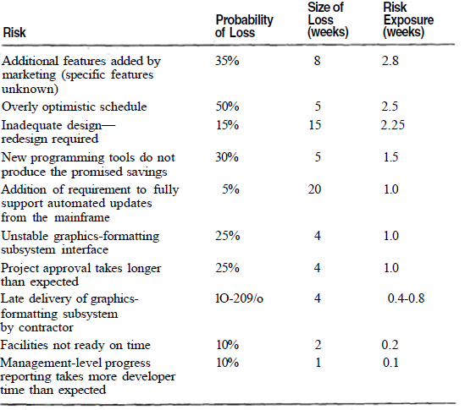
Example of a Prioritised Risk-Assessment Table

Slide 18
Risk Control: Risk-Management Planning
After you've identified your project's risks, analysed their probabilities and magnitudes, and prioritised them, you're ready to control them.
Risk-Management Planning: the focus of risk-management planning is to develop a plan to handle each of the high-priority risks identified during the previous activities.

Slide 19
Risk Management Processes
The goal of project risk management is to minimize potential risks while maximizing potential opportunities. Major processes include
Risk Management Planning: deciding how to approach and plan the risk management activities for the project
Risk Identification: determining which risks are likely to affect a project and documenting their characteristics
Qualitative Risk Analysis: characterizing and analyzing risks and prioritizing their effects on project objectives

Slide 20
Project Risk Management Processes
Quantitative Risk Analysis: measuring the probability and consequences of risks
Risk Response Planning: taking steps to enhance opportunities and reduce threats to meeting project objectives
Risk Monitoring and Control: monitoring known risks, identifying new risks, reducing risks, and evaluating the effectiveness of risk reduction

Slide 21
Types of Risks
Schedule Risks
    Schedule compression (customer, marketing, etc.)
Cost Risks
    Unreasonable budgets
Requirements Risks
    Incorrect
    Incomplete
    Unclear or inconsistent
    Volatile
Quality Risks
Operational Risks

Slide 22
Assignment 2
What are the types of Risk, explain them
Give example of each type of risk
Individual Assignment
No late submissions
Due date 20th April 2011
Submissions only through LMS
Plagiarized work will be marked 0

